Slide 1
Game Analysis With SQL
Task Given by Mentorness
By ~ Sumit Mishra

Slide 2



Content
Objectives
Queries
Topics cover

Slide 3
Objective
IN This Task We Have Two Different Dataset
Player Details
Level Details
Create new database named “Game analysis” and import these dataset into database.
Now Aims To Analyze Player Behavior Data From A Gaming Dataset By Extracting Insights Using SQL Queries.
We Have 15 Queries To Find There Answers Using MySQL Workbench.

Slide 4
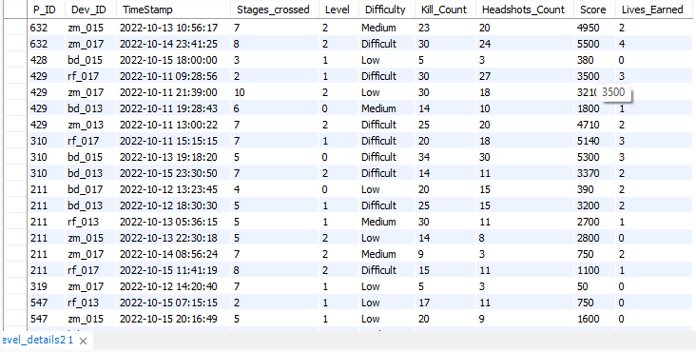
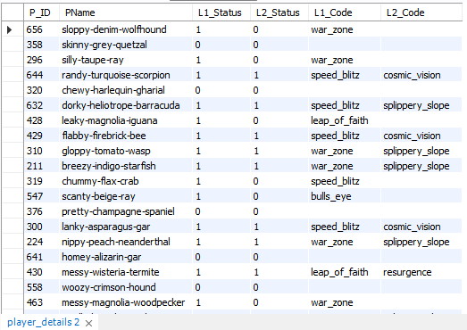
Dataset
Level Details
Select * from Level_details2
Player details
Select * from Player_details

Slide 5
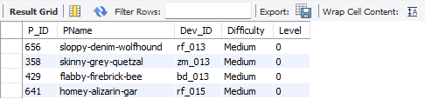
Q1) Extract P_ID,Dev_ID,PName and Difficulty_level of all players at level 0
select P.P_ID, P.PName, LD.Dev_ID, LD.Difficulty, LD.Level
from player_details as P
join level_details2 as LD ON P.P_ID = LD.P_ID
where LD. Difficulty = "Medium" And LD.Level = 0;

Slide 6

Q2) Find Level1_code wise Avg_Kill_Count where lives_earned is 2 and atleast 3 stages are crossed ?
select P.L1_code as Level, avg(LD.Kill_Count) AS Avg_Kill_Count
from level_details2 as LD
join player_details as P on P.P_ID = LD.P_ID
where LD.Lives_Earned = 2
group by P.L1_code
having count(distinct stages_crossed) >= 3;

Slide 7
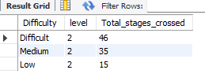
Q3) Find the total number of stages crossed at each diffuculty level where for Level2 with players use zm_series devices. Arrange The result in decreasing order of total number of stages crossed.
select Difficulty, level, sum(Stages_crossed) as Total_stages_crossed
from level_details2 as LD
join player_details as P on P.P_ID = LD.P_ID
where LD.level = 2 and LD.Dev_ID Like '%zm%’
group by Difficulty
order by Total_stages_crossed desc;

Slide 8
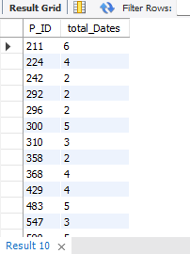
Q4) Extract P_ID and the total number of unique dates for those players who have played games on multiple days.
select P_ID, count(distinct TimeStamp) as total_Dates
from level_details2
group by P_ID
having count(distinct TimeStamp) > 1;

Slide 9
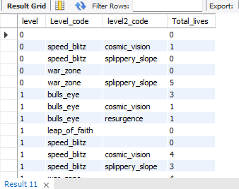
Q5) Find P_ID and level wise sum of kill_counts where kill_count is greater than avg kill count for the Medium difficulty.
select P_ID, Level, sum(kill_count) as Total_kill_counts
from level_details2
where kill_count > (select avg(kill_count)
from level_details2 as LD
join player_details as P on LD.P_ID = P.P_ID
where LD.Difficulty = "medium")
group by P_ID, Level;

Slide 10
Q6) Find Level and its corresponding Level code wise sum of lives earned excluding level 0. Arrange in asecending order of level.
select LD.Level as level, P.L1_Code as Level_code, P.L2_code as level2_code, sum(LD.Lives_Earned) as Total_lives
from player_details as P
join level_details2 as LD on LD.P_ID = P.P_ID
where LD.Level >= 0
group by LD.Level, P.L1_code, P.L2_code
order by LD.Level asc;

Slide 11
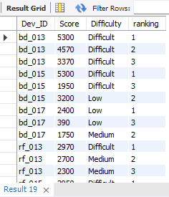
Q7) Find Top 3 score based on each dev_id and Rank them in increasing order using Row_Number. Display difficulty as well.
select Dev_ID, Score, Difficulty, ranking
from (select Dev_ID, Score, Difficulty, row_number() over(partition by Dev_ID order by Score desc) as ranking
from level_details2
where Dev_id is not null and Score is not null and Difficulty is not null)as rank_score
where ranking <=3
order by Dev_ID, Difficulty;

Slide 12
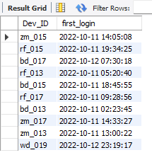
Q8) Find first_login datetime for each device id
select Dev_ID, min(Timestamp) as first_login
from level_details2
group by Dev_id;

Slide 13
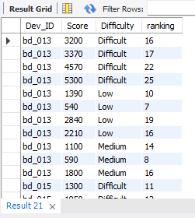
Q9) Find Top 5 score based on each difficulty level and Rank them in increasing order using Rank. Display dev_id as well.
select Dev_ID, Score, Difficulty, ranking
from (select Dev_id, Score, Difficulty, rank() over(partition by Difficulty order by Score asc) as ranking
from level_details2
where Dev_id is not null and Score is not null and Difficulty is not null)as rank_score
where ranking >= 5
order by Dev_ID, Difficulty;

Slide 14
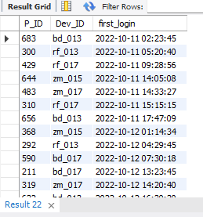
Q10) Find the device ID that is first logged in(based on start_datetime) for each player(p_id). Output should contain player id, device id and first login datetime.
select LD.P_ID, LD.Dev_ID, LD.TimeStamp as first_login
from level_details2 as LD
join(select P_ID, min(TimeStamp) as f_login
from Level_details2
group by P_ID)as f_login_per_player on LD.P_ID = f_login_per_player.P_IDand LD.TimeStamp = f_login_per_player.f_login
order by first_login asc;

Slide 15
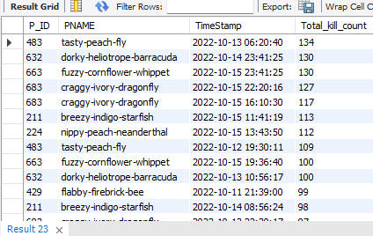
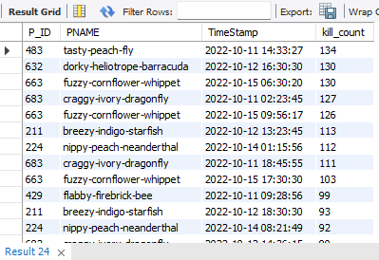
Q11) For each player and date, how many kill_count played so far by the player. That is, the total number of games played by the player until that date.
a) window function
select P.P_ID,P.PNAME,TimeStamp, sum(Kill_count) over(partition by PNAME order by TimeStamp) as Total_kill_count
from player_details as P
join Level_details2 as LD on P.P_ID = LD.P_ID
order by Total_kill_count desc;
b) without window function
select P.P_ID, P.PNAME, LD.TimeStamp,
(select sum(LD2.Kill_count)
from Level_details2 as LD2
where LD2.P_ID = P.P_ID and LD2.TimeStamp >= LD.TimeStamp ) as kill_count
from player_details as p
join level_details2 as LD on P.P_ID = LD.P_ID
order by kill_count desc;

Slide 16
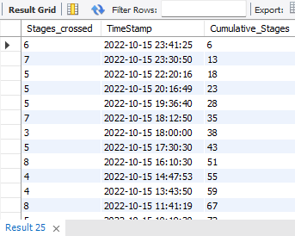
Q12) Find the cumulative sum of stages crossed over a start_datetime
select Stages_crossed, TimeStamp, sum(Stages_crossed) over(order by TimeStamp desc) as Cumulative_Stages
from level_details2;

Slide 17
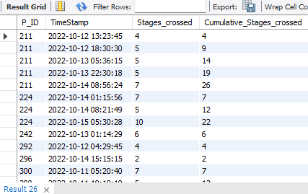
Q13) Find the cumulative sum of an stages crossed over a start_datetime for each player id but exclude the most recent start_datetime
select P_ID, TimeStamp, Stages_crossed, sum(Stages_crossed) over(partition by P_ID order by TimeStamp) as Cumulative_Stages_crossed
from Level_details2
where TimeStamp < (selectmax(TimeStamp)
from Level_details2 as LDwhere LD.P_ID = level_details2.P_ID);

Slide 18
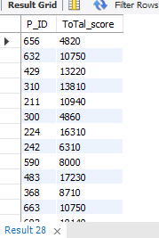
Q14) Find players who scored more than 50% of the avg score scored by sum of scores for each player_id
select P_ID, sum(score) as ToTal_score
from level_details2group by P_ID
having sum(Score) > 0.5 * (select avg(sum_score)
from (select sum(score) as Sum_Score from Level_details2
group by P_ID) as avg_score);

Slide 19
Q15) Create a stored procedure to find top n headshots_count based on each dev_id and Rank them in increasing order using Row_Number. Display difficulty as well.
delimiter //
drop procedure if exists TopNHead;
create procedure TopNHead(in n int)
begin
select Dev_ID, Headshot_Count, Difficulty
from (select Dev_ID, Headshot_Count, Difficulty, Row_number() over(partition by Dev_ID order by Headshot_Count) as ranked
from Level_details2) as high_rank
where ranked <= n;
end //
delimiter;
call TopNotchHead(3)

Slide 20
Topics cover
Aggregators
Store Procedure
Sub Queries
Windows Function

Slide 21
“Thank you
For
Watching”

